Slide 1


Cultural Christianity
RCCG Sunday School
9 June 2024 Lesson 41

Slide 2
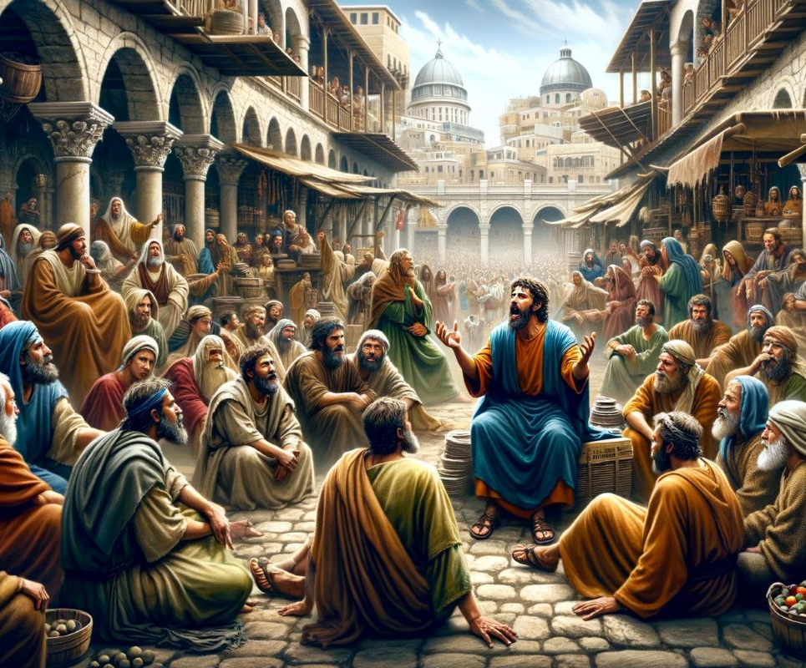
Memory Verse: Acts 11:26 (KJV)
And when he had found him, he brought him unto Antioch. And it came to pass, that a whole year they assembled themselves with the church; and taught much people.
And the disciples were called Christians first in Antioch.

Slide 3
Text: - Matthew 7:21-23 (KJV)
Imagine someone raised in a traditional belief system, where following rituals and customs is key.
They might call upon a higher power for guidance (Lord, Lord). But Jesus warns that simply following traditions won't guarantee entrance into the kingdom of heaven.
True faith comes from following the will of the Father in heaven.
In the future, some might claim their traditional practices were enough, but Jesus emphasizes a deeper connection is needed.
He might say, 'These traditions never brought you any closer to me.’
True faith requires following a different path. Iniquity violates the core principles of this new way of living.

Slide 4
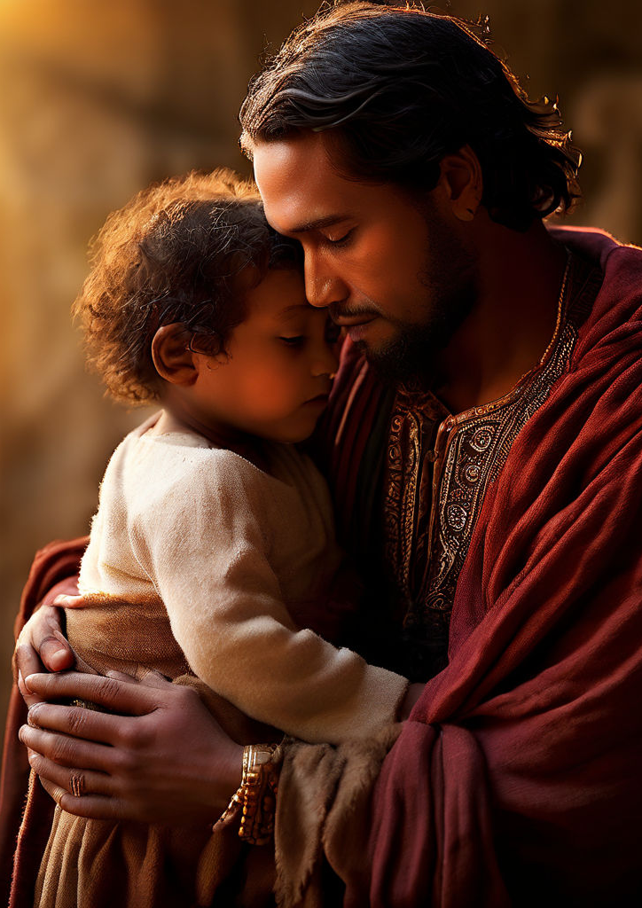
More Than Just Tradition
Christianity isn't just about going through the motions. It's about a daily connection with God, a close and personal relationship (like Romans 10:9-10 says). The word "Christian" itself started way back with the first followers of Jesus (Acts 11:26). They were so close to Jesus that people even called them "mini-Jesuses"!
Sadly, nowadays, some people see Christianity as a set of ideas or a social club, rather than living a life that follows God's teachings. There are actually two main ways people approach Christianity: cultural Christianity and biblical Christianity. Let's explore the difference between these two.

Slide 5
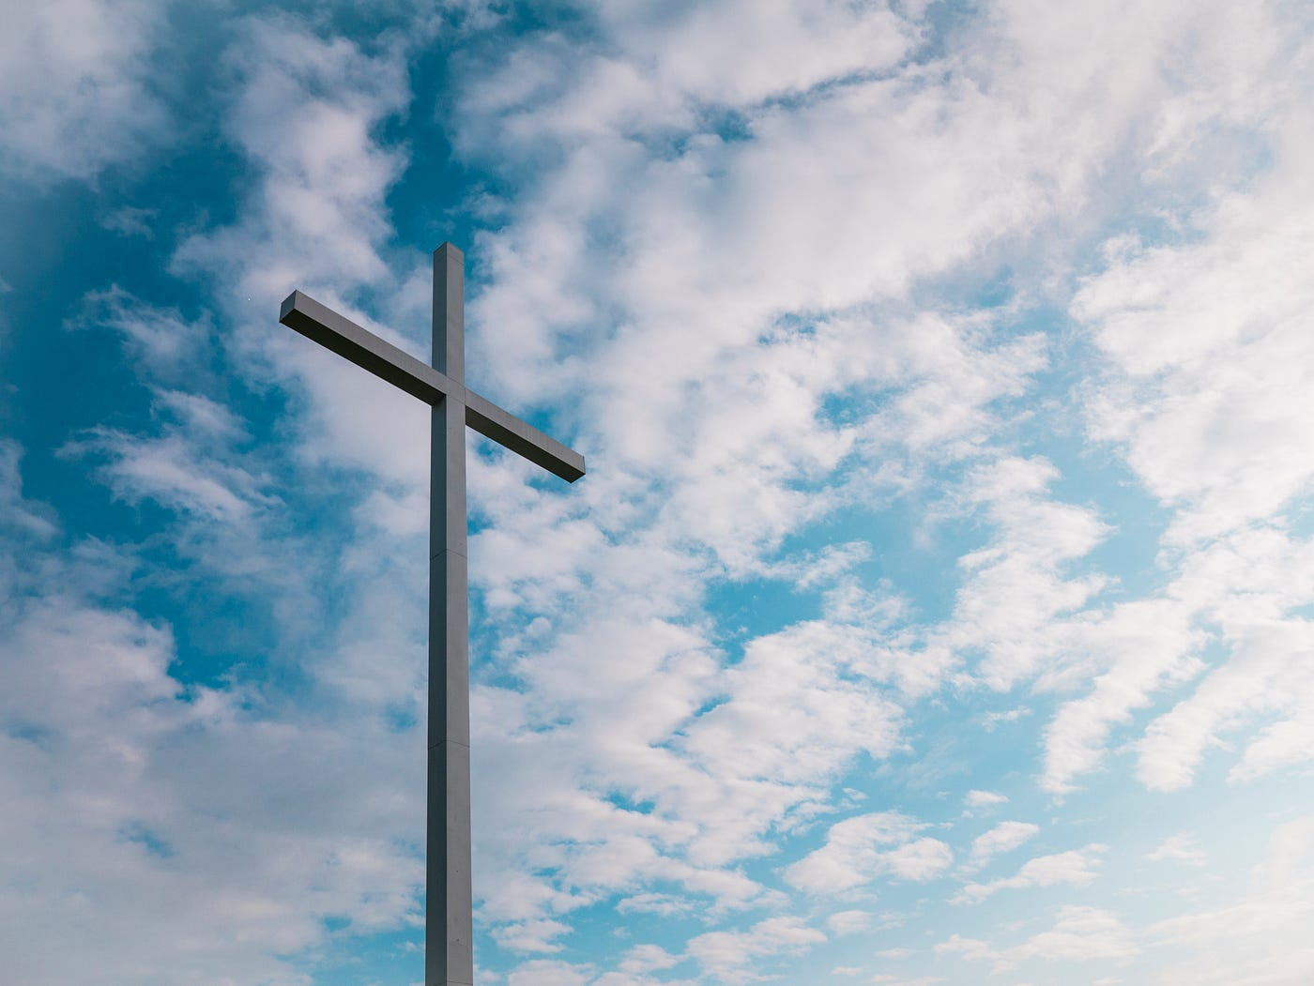
Christianity by Culture
Cultural Christians are people who might say they're Christian, but it's more about habit or background than a deep belief. The core spirituality of Christianity is not part of their lives. Cultural Christianity is:
Following the crowd: more about fitting in than having a personal relationship with God.
The label over the life: might wear the holy label, but their actions don’t reflect deep faith.
Parts of the story, not the whole: like some aspects of Jesus' teachings, but not the commitment Christianity requires.
Also includes - family tradition, going to church sometimes, or just because they live in a Christian society. But true Christianity is about deep faith and commitment.

Slide 6
Signs of "Going Through the Motions“ (1)
Here are some things that might show someone isn't following Christianity as closely as the Bible teaches:
Picking and choosing what to believe from the Bible: They might not believe everything the Bible says.
Skipping the "sorry" step: They might not take responsibility for their mistakes.
Focusing only on the good stuff: They might only like the parts of Jesus' teachings that are easy and happy.
Living however they want: They might say they know God, but keep doing things God wouldn't like.
Changing the rules to fit their life: They might try to twist the Bible's meaning to fit how they want to live.

Slide 7
Signs of "Going Through the Motions“ (2)
Taking God's promises for granted: They might expect God to bless them without following His teachings.
Thinking Jesus is just one option: They might not believe Jesus is the only way to heaven.
Going to church just to feel good: They might go to church out of habit, not because they truly want to be closer to God.
Seeing God as a vending machine: They might think God gives them good things only if they do certain things.
Picking a church for the wrong reasons: They might choose a church based on things other than wanting to learn more about God.
Remember, true Christianity is about having a close relationship with God and trying to live your life the way the Bible teaches.

Slide 8
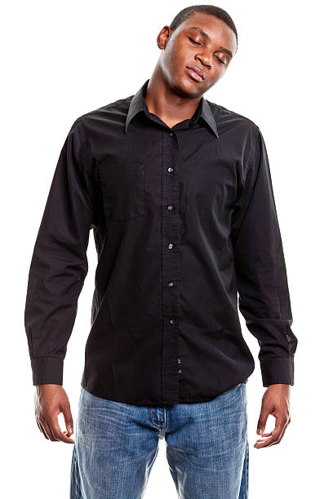
Conclusion: A Wake-Up Call from Jesus
Jesus' words in Matthew 7:21-23 can be a powerful reminder for cultural Christians. He warns that simply calling him "Lord" or doing good deeds isn't enough. True Christianity involves a deep relationship with God and a commitment to living according to his teachings.
If following Jesus and growing closer to him is important to us, we should examine our hearts and actions. Are we just going through the motions, or are we truly trying to live a life that honours God?

Slide 9
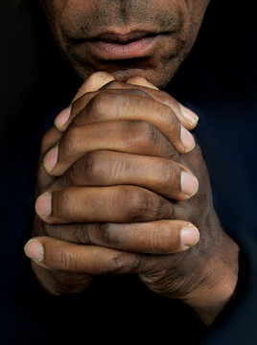
Prayers
Dear Heavenly Father,
Awaken my heart, towards a more authentic faith.
Grant me a hunger to truly know you and follow your teachings.
Breathe new life into me and let me connect with you
In Jesus' name, Amen.

