Slide 1


23 June 2024 Lesson 43
Fulfilling Purpose
RCCG Sunday School
Notes:
OPENING PRAYER: Almighty Father, please help me to fulfil the purpose for which You created me in the name of Jesus.

Slide 2
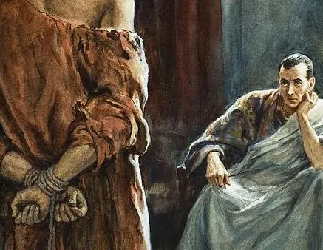
Memory Verse
John 18:37
Pilate therefore said unto him, Art thou a king then? Jesus answered, Thou sayest that I am a king. To this end was I born, and for this cause came I into the world, that I should bear witness unto the truth. Every one that is of the truth heareth my voice.

Slide 3


Philippians 3:12-14 (KJV)
In this passage, Paul says:
I haven't reached my goal or become perfect yet, but I keep pushing forward to capture the purpose for which Christ chose me.
I don't dwell on past victories; instead, I focus entirely on what lies ahead.
I'm determined to reach the finish line, for the prize is the incredible life God has planned for me in Christ Jesus.

Slide 4

Introduction
The natural world around us hums with purpose. From the life-giving light of the sun to the nourishing rain from the clouds, each element plays a vital role. Yet, amidst this purposeful existence, humanity can often feel lost, grappling with the question: "What is my purpose?“
This lesson delves into the divine design behind human existence. We'll explore how to discover the unique purpose God has for each of us and equip ourselves with the tools to fulfill that calling with meaning and joy.

Slide 5

Discover Your Purpose In Life
Like Apostle Paul, once you become a new creation in Christ, you must begin to crave for the understanding of your purpose for living on earth.
That purpose has been predetermined by God before you were born.
It is your duty to discover and fulfil it.

Slide 6

A. Potential
You need to identify your in-built ability, your talents, and God-given gifts.
Find out the things you do with less stress e.g., singing, drawing, talking to a crowd, helping others, etc.
The knowledge or skills you acquire in life should be to shape and sharpen your potential

Slide 7

B. Passion
What are those things you exceptionally have flare or zeal for, and do often?
Build your vocation or career on such things.
The things that get you excited, give you joy, and satisfaction can lead you to the fulfilment of your purpose in life (Psalm 69:9; Colossians 4:12-13).

Slide 8

C. Prayer
After you have identified your potential and the things you are passionate about, you need to pray for divine guidance, so that the world and the enemy will not hijack your purpose in life.

Slide 9
Live to Fulfil Purpose (1)
These seven things will help every child of God fulfil his/her purpose in life:
Ask God to reveal His plan for your life to you. Then, draw a vision and mission statement.
Set achievable goals and pursue them. Take a step at a time and do not be mediocre.
Identify and relate with people of like passion: learn from their mistakes and build on their success.

Slide 10
Live to Fulfil Purpose (2)
Submit yourself for mentoring and counselling: do not claim to know it all
Live as if you have just one more day on earth: do not procrastinate.
Focus your attention on God. Make sure all that you do is to His pleasing.
Always return all the glory to God: do not ascribe anything to yourself.

Slide 11
Conclusion
So many people live and die without leaving any positive mark. Be different. You are not a nonentity.
Consider what mark you want to leave on the world. What gifts and talents do you possess? How can you use them to make a difference?
Fulfilling your purpose isn't always about grand gestures; it's about living authentically and contributing to the greater good in your own way.

Slide 12

Prayers
Dear Jesus,
Guide me as I seek purpose
Open my eyes to see what you have made me for
Guide me as I walk in purpose
In Jesus name

