Slide 1


Christian Virtues
Sunday School 14 July2024

Slide 2

Text: 2 Peter 1:3-7
  God provides: We have everything for a godly life through knowing Him.
  God promises: Great promises to share in His nature and escape worldliness.
  Grow in character: Add goodness, knowledge, self-control, perseverance, godliness, kindness, and love to your faith.

Slide 3

Introduction - Virtues
  Two Greek words for "virtue"
    Dunamis: miraculous power
    Arete: moral excellence, goodness
  Virtue as a disposition:
    Habitual way of thinking and acting
    Not impulsive, but settled
    Shapes motives, intentions, and behavior

Slide 4

Attaining Virtue
    God equips: We have what we need for godly living.
    Godly growth: Aim to be like God.
    Follow God's plan: His ways lead to virtue.
    Build character: Faith, goodness, knowledge, self-control, perseverance, godliness, kindness, love.

Slide 5
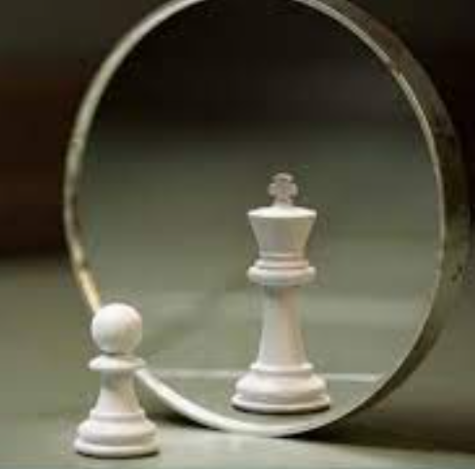
The Desire to Excel
    Recognize excellence: Understand what it is and your shortcomings.
    Model yourself after Christ: He is the ultimate example.
    Sacrifice and effort: Give up lesser things, work hard for improvement.
    Be teachable: Learn from anyone, regardless of position.

Slide 6
Conclusion
  Virtues shape our lives: Possessing and growing in these virtues leads to a meaningful Christian life.
  Fruitful living: Developing these character traits results in a productive and fulfilling life for Christ.
  Purposeful existence: A life marked by these virtues is aligned with God's purpose.

