Slide 1
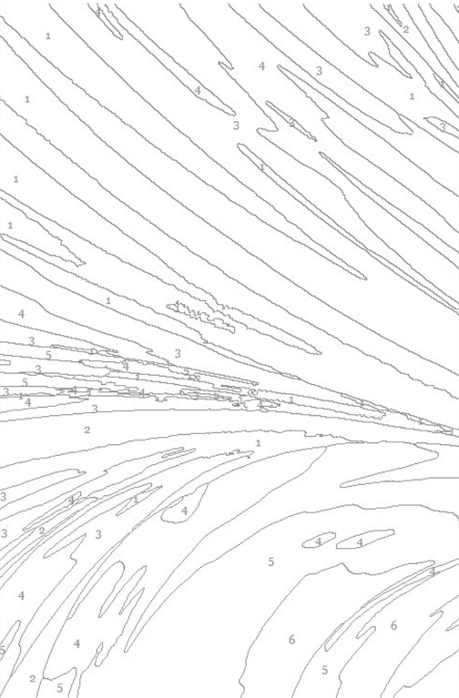


RCCG Sunday School
Lesson 49 (4/8/24)
The Great Tribulation

Slide 2
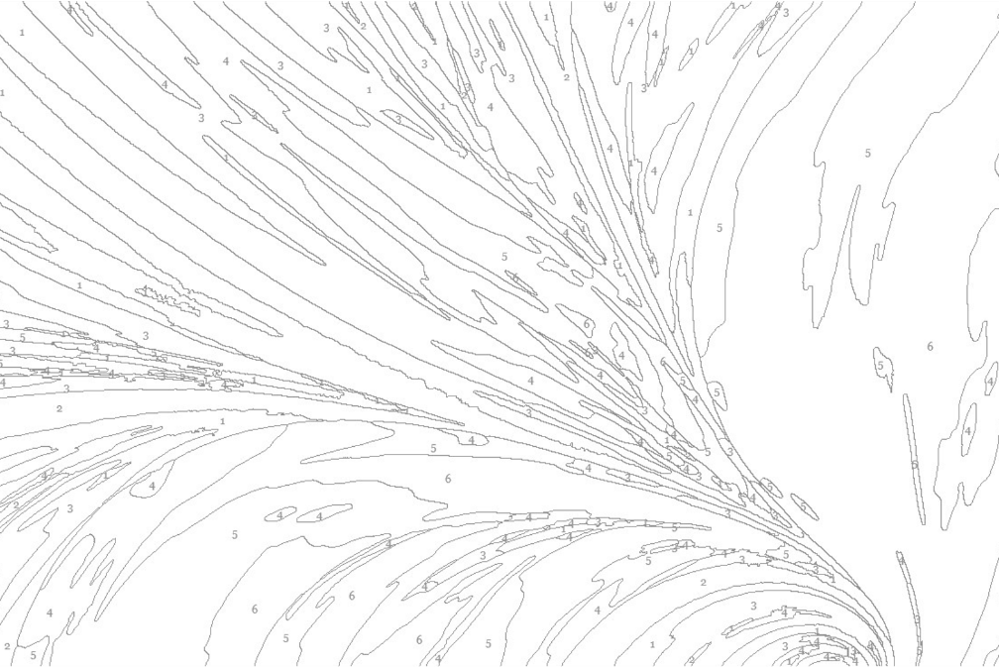
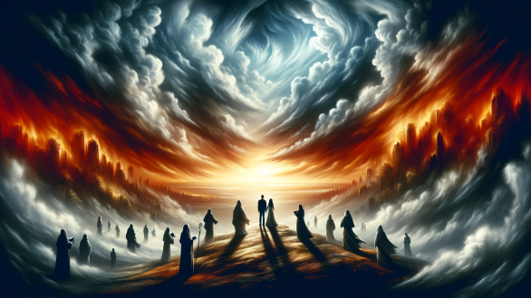
Mark 13:19-26 (KJV)
Severe suffering will occur.
God shortens this time for His chosen.
False Christs and prophets will appear.
Be cautious and remember Jesus' teachings.
Dramatic natural disasters and celestial events.
Jesus returns with power and glory.
Jesus gathers His chosen ones.

Slide 3

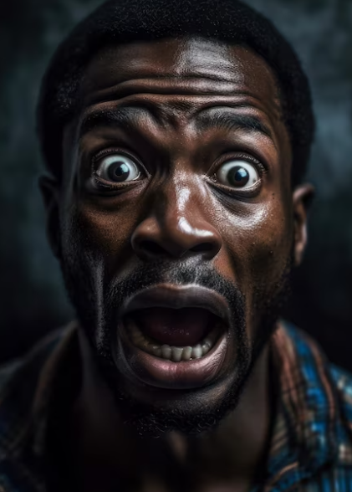
Tribulation Explained
Tribulation refers to various forms of suffering.
The Great Tribulation is a unique period of intense hardship.
This period will be unprecedented in severity.
Key questions: What is it? When will it occur? What events mark it?

Slide 4
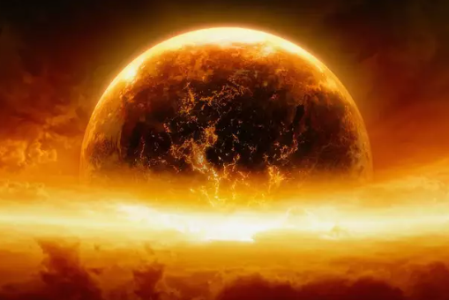
The Great Tribulation
Severe suffering for unbelievers.
Follows the Rapture and Antichrist's rise.
Seven-year period.
Antichrist's rule divided into two parts
Ends with Christ's return

Slide 5
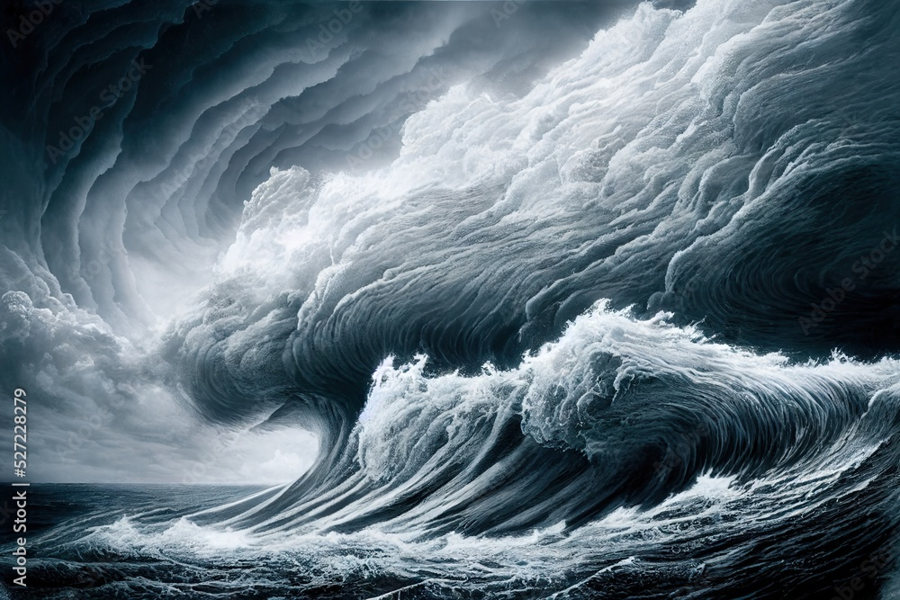
Events of the Great Tribulation
Severe persecution of believers.
Widespread religious deception.
Global economic collapse and the mark of the beast.
Rise of false religions and practices.
Intense worldwide temptation.

Slide 6
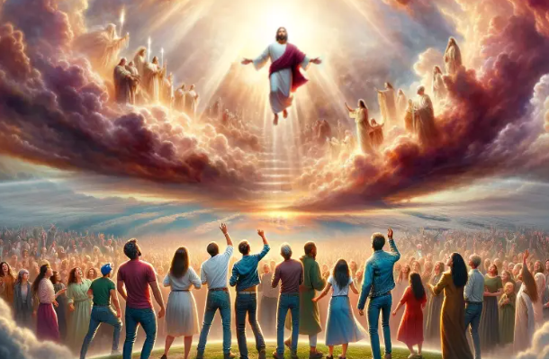

Conclusion
Believers who endure in faith will be raptured before the Tribulation.
Unbelievers/backsliders face the Tribulation's horrors.
Examine your salvation and ensure spiritual security.

Slide 7
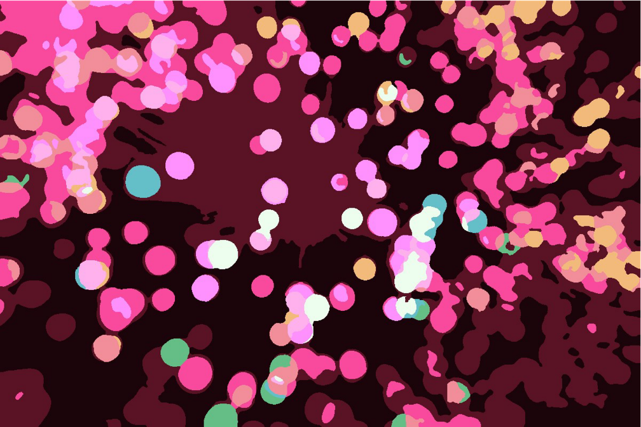
Prayers
Heavenly Father,
We trust in Your perfect timing and Your sovereign plan. Please rapture us from this earth before such trials
Spare us from experiencing the horrors of the Great Tribulation.
Let Your grace and mercy be upon us always.
In Jesus’ name, we pray. Amen.

