Slide 1
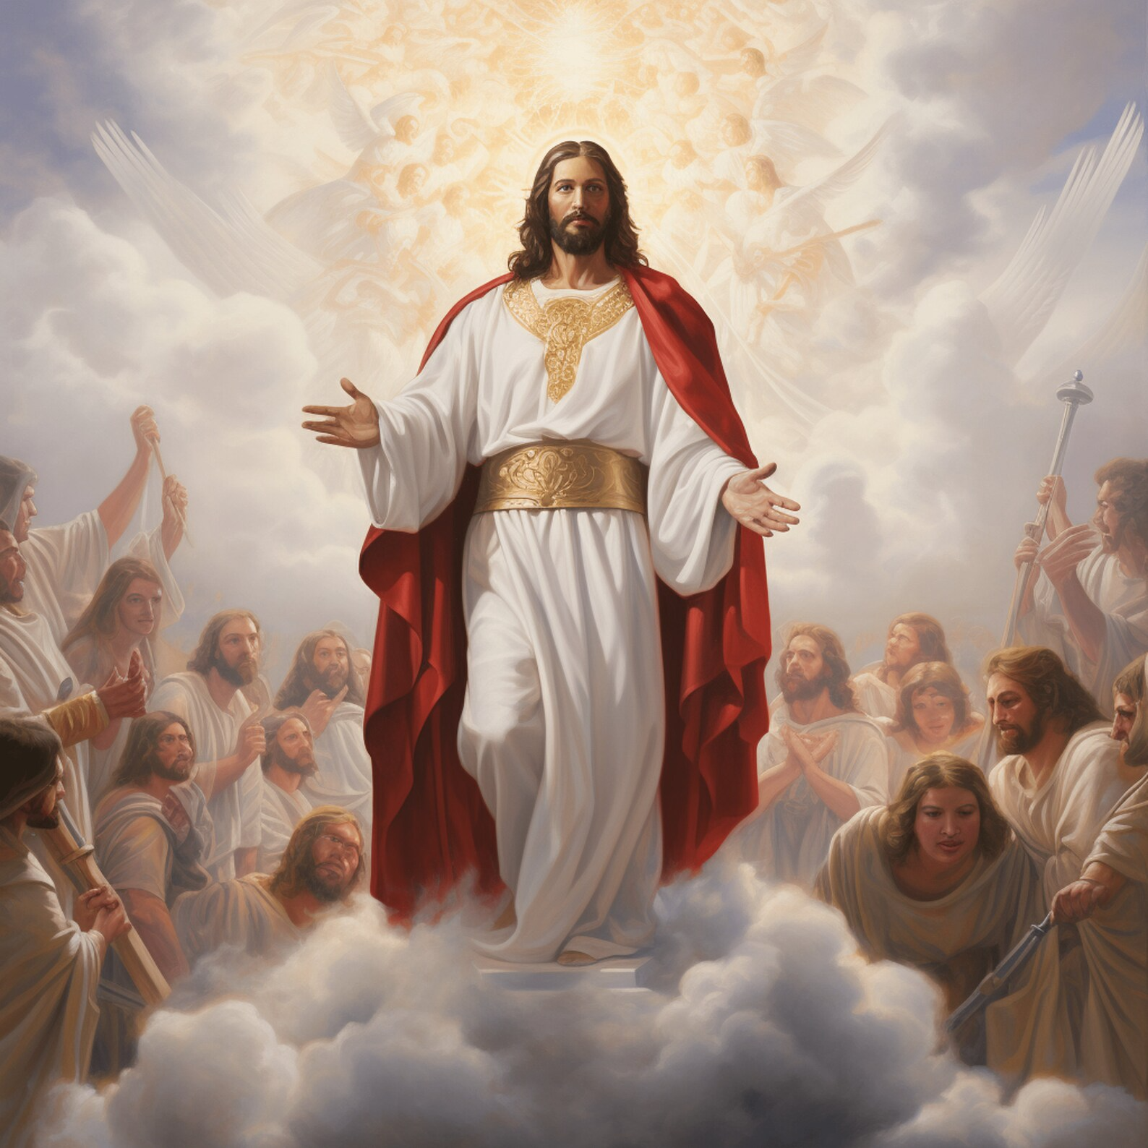

THE
SECOND COMING
OF CHRIST
SUNDAY SCHOOL – LESSON 48

Slide 2
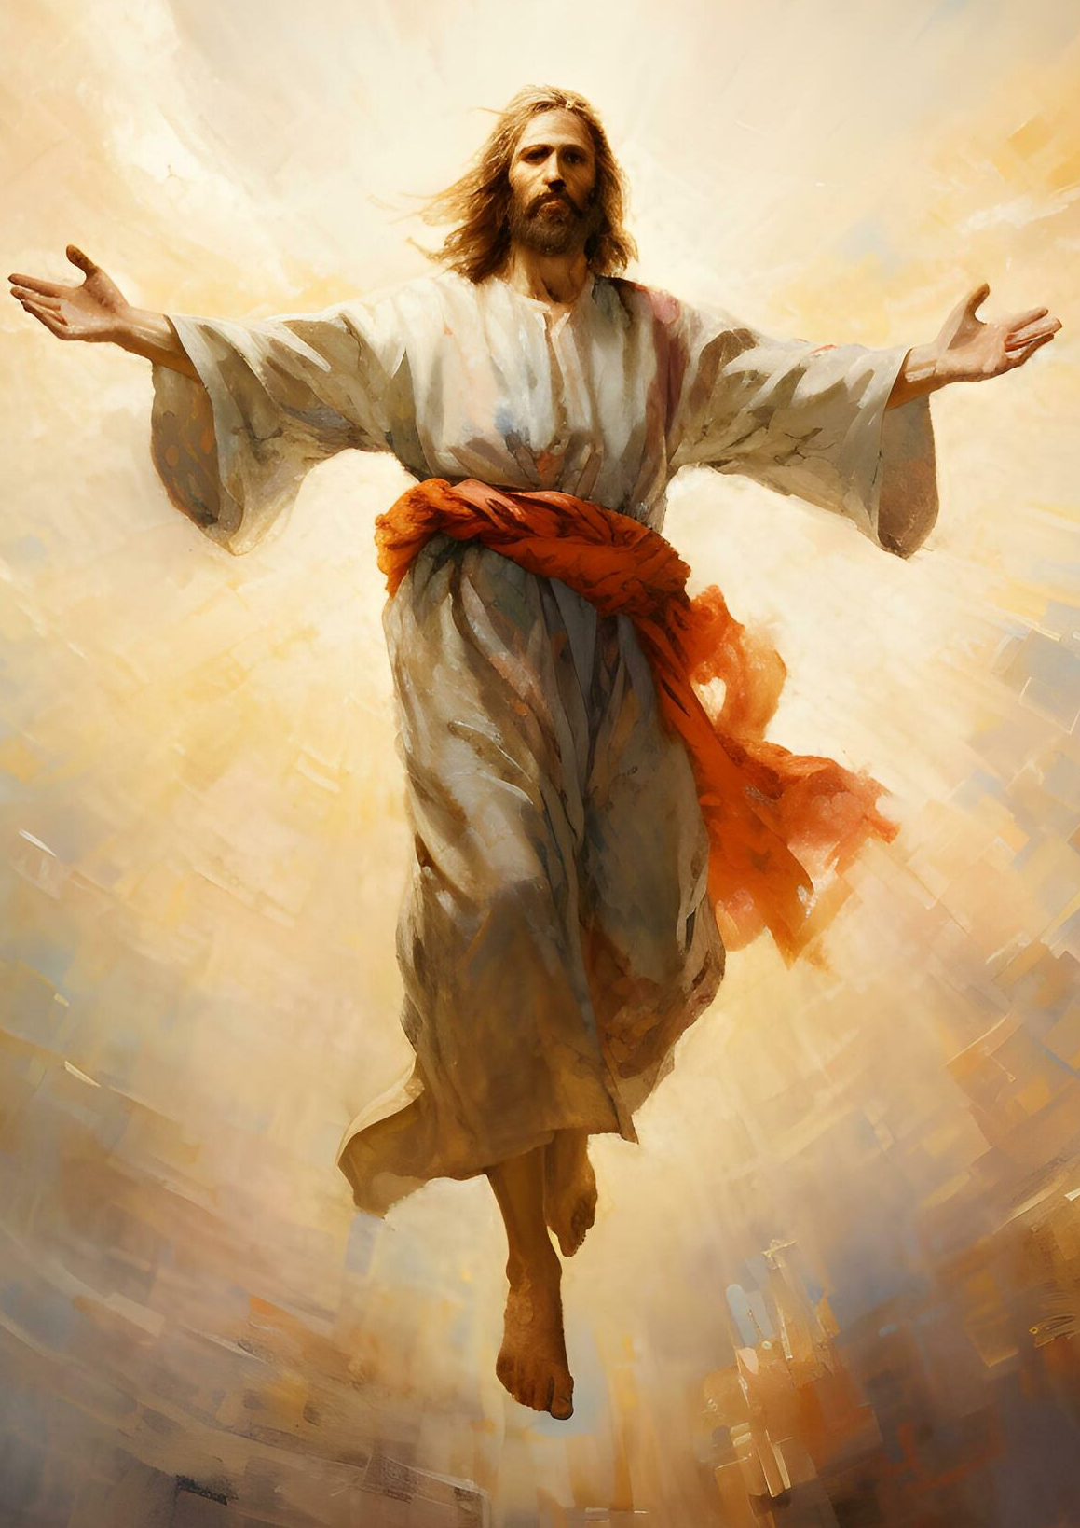
1 THESSALONIANS 4:13-18
Don't be sad about those who have died.
Believers will be resurrected when Jesus returns.
Those alive at Jesus' return will meet Him in the sky.
We will be with Jesus forever.
Encourage each other with this hope.

Slide 3
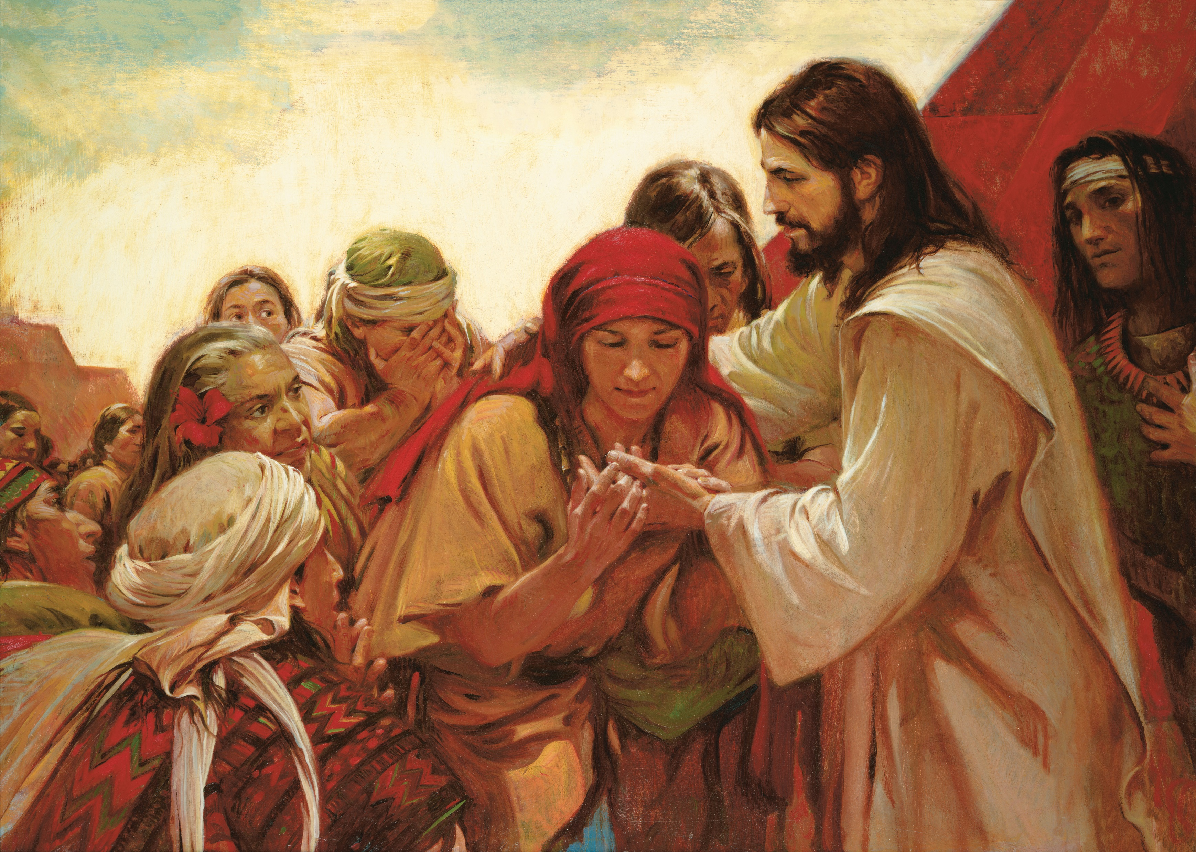
INTRODUCTION
Jesus ascended bodily and visibly with power
Jesus will return in the same way:
  Rapture: Jesus comes for His believers
  Second Coming: Jesus comes with His believers to establish His kingdom
The Great Tribulation occurs between these two phases.

Slide 4
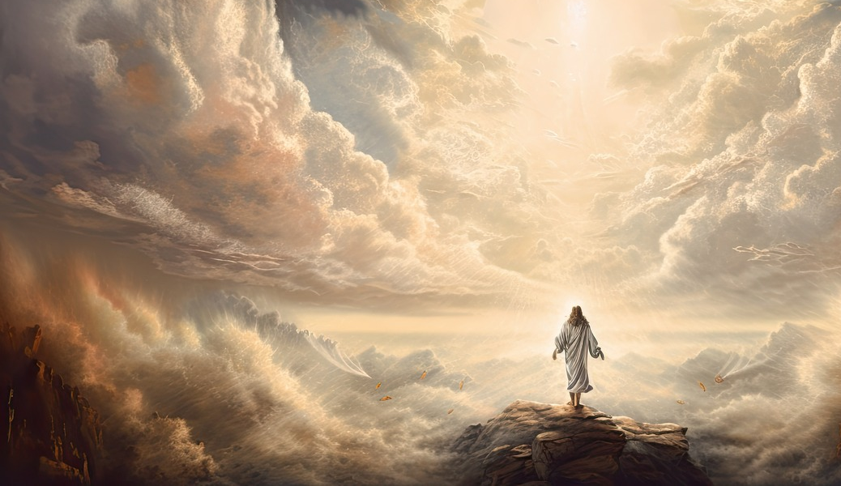
PROPHECIES & PURPOSE
Jesus' first coming was prophesied and fulfilled.
His second coming is also prophesied.
Purpose:
  Complete salvation of believers
  Reveal hidden truth
  Receive believers to be with Him
  Glorify saints/Execute judgment
  Reign as King/Destroy death

Slide 5
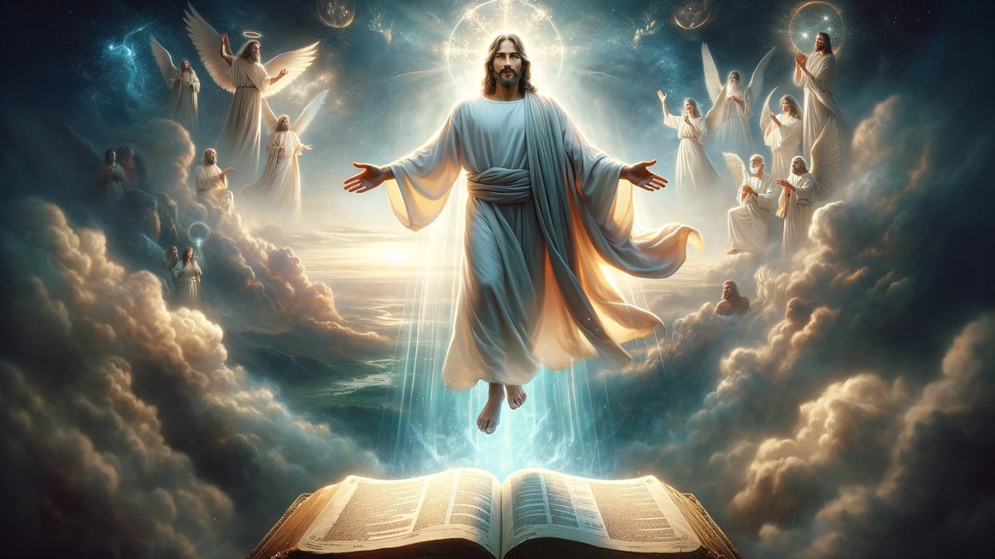
FIRST PHASE – RAPTURE
Descends from heaven with a shout
Sudden appearance
In Father's glory
Saints meet Him in the air and are with Him forever

Slide 6
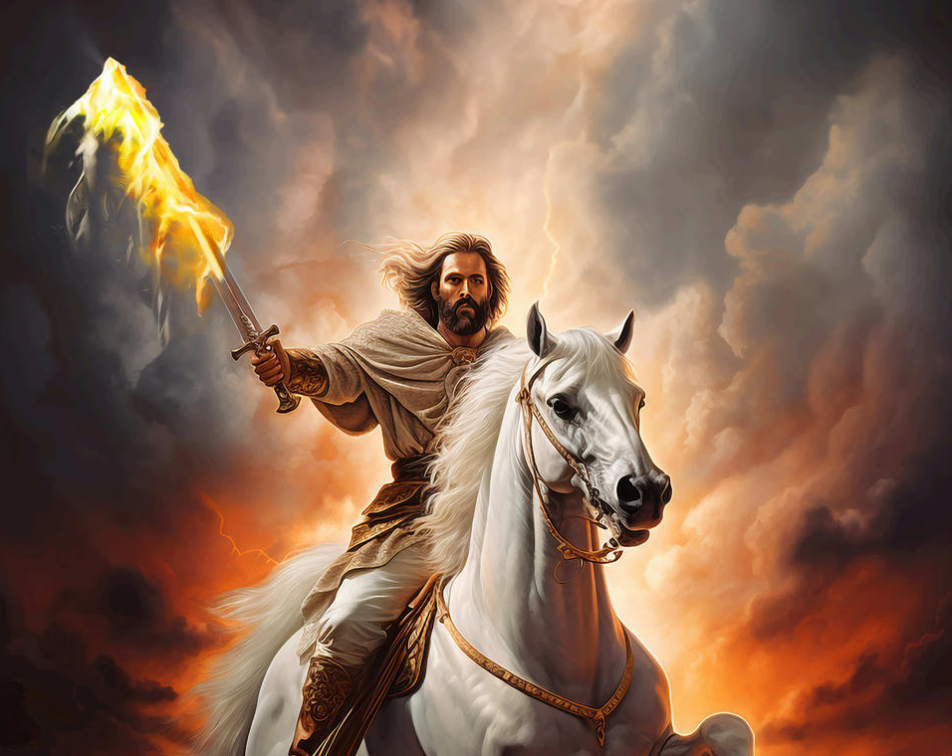
SECOND PHASE - REVELATION
Comes to earth in clouds with power and glory
Comes with angels and saints
Comes in flaming fire
Returns bodily
Comes to earth in clouds with power and glory
Comes with angels and saints
Comes in flaming fire
Returns bodily

Slide 7
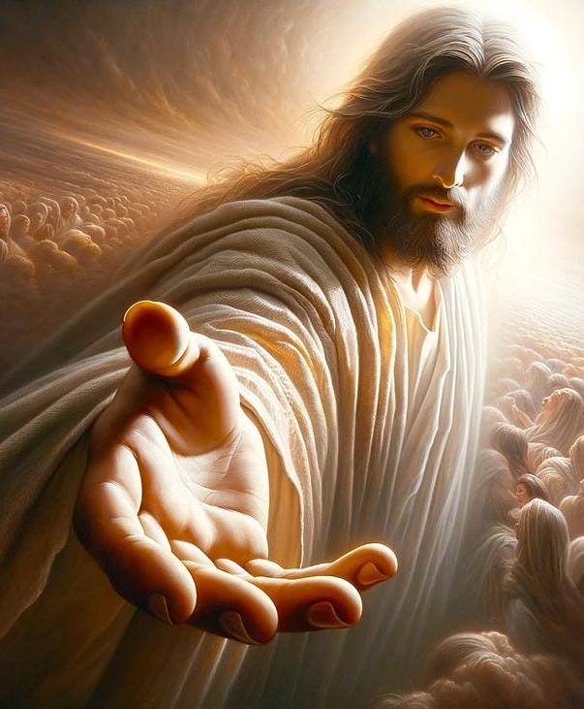
CONCLUSION
Christ's return is certain.
Live a holy life, as if He could return today.
Plan for the future, but stay ready.
Watch and Pray.

Slide 8


PRAYERS
Dear Father,
Please give me a heart of readiness and anticipation
Use me in evangelism and preparing the church
Help me to be holy
In Jesus name

