Slide 1
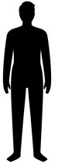

The Creature Called Man
Sunday School
22 Sep 2024
Lesson 4

Slide 2
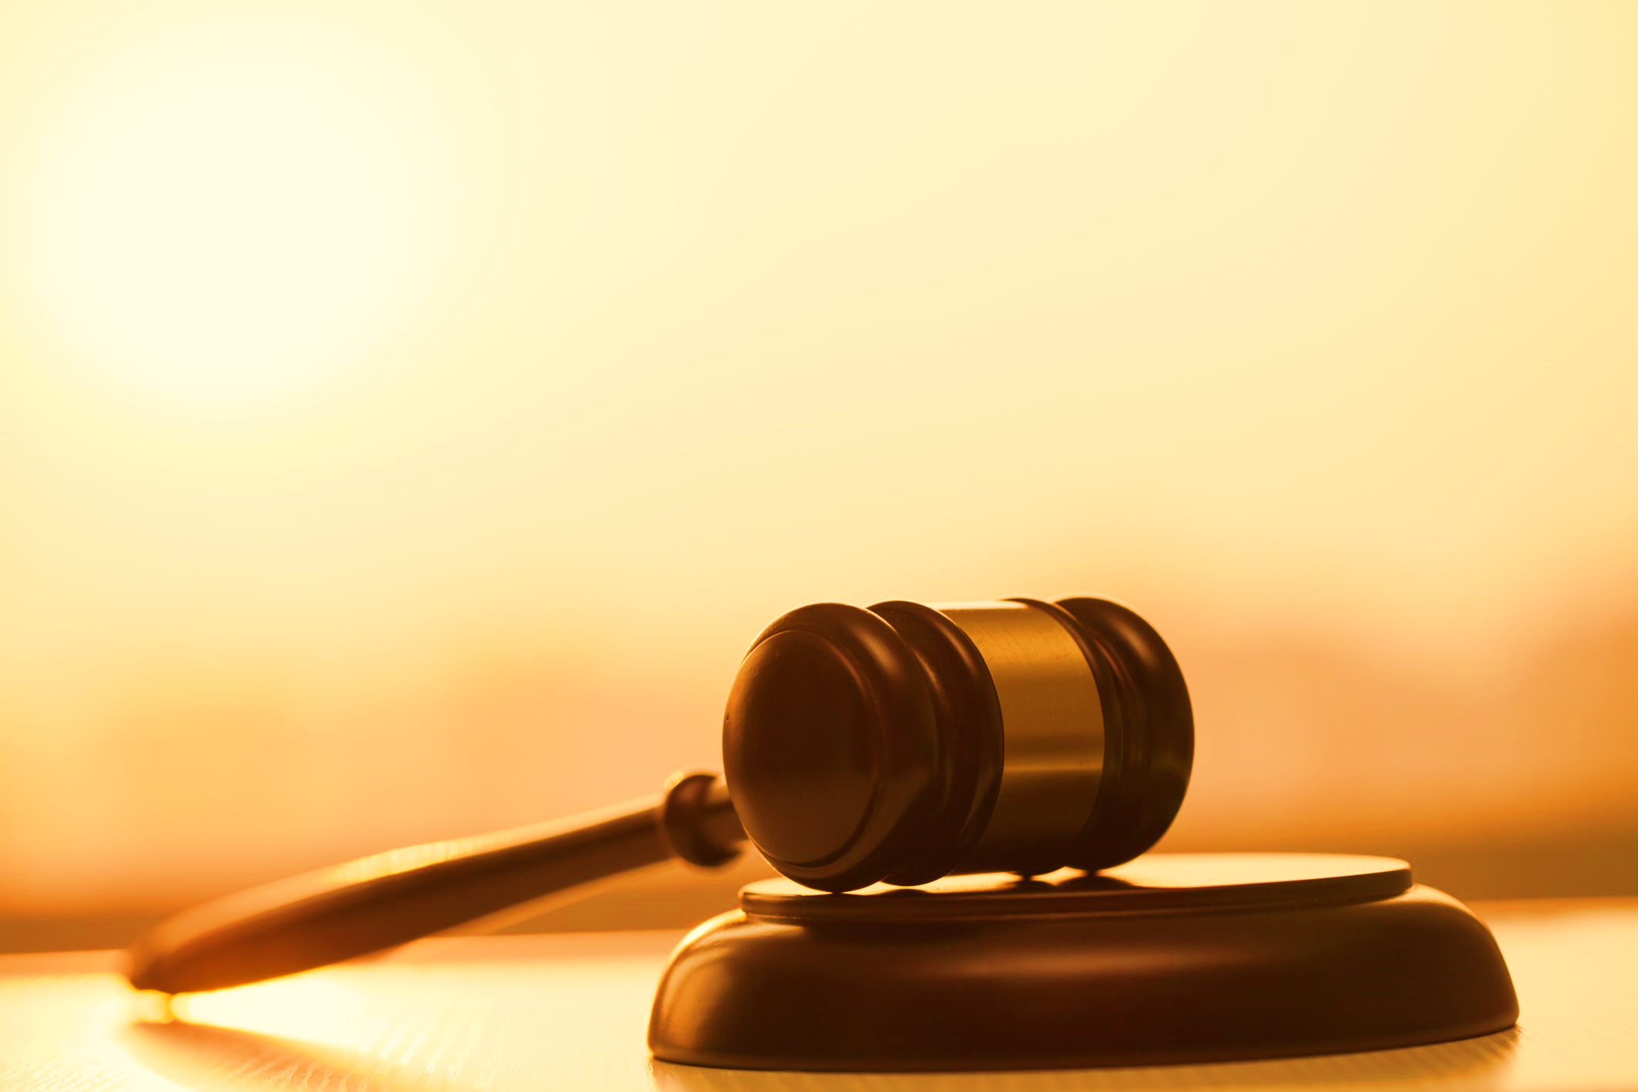

Ezekiel 18:4-9 Summary
Individual Accountability: Each person is responsible for their own actions and consequences.
Righteous Living: Righteousness includes:
  Avoiding idolatry
  Respecting marital vows
  Treating others fairly
  Helping the needy
  Avoiding oppression and usury
Rewards for Righteousness: Those who live righteously will live forever.

Slide 3

Introduction
Soul Creation: God created the soul, made in His image.
Intangibility: The soul, being intangible, couldn't interact with the physical world.
Body Formation: God created a physical body from the dust of the earth.
Life Breath: God breathed life into the body, combining it with the soul to create a living being.

Slide 4
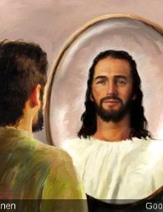
God's Image on Man
Nature and Constitution:
  The soul is the image of God.
  The soul is intelligent, immortal, and intangible.
  Man resembles God in creativity and willpower.
Place and Authority:
  Man is God's representative on earth.
Purity and Integrity:
  God's image includes knowledge, righteousness, and true holiness.

Slide 5
The Tripartite Man
Spirit: Breath of life given by God, returns to God on death.
Method of communication with God
Soul:
  Intangible being.
  Gives personality, self-awareness, consciousness, rationality, and natural feeling.
  Receives salvation.
  Guided by the spirit for acceptable worship.
  Stands in judgment.
  Destination: Heaven or Hell.
Body:
Physical being made from clay.
Temporal and becomes lifeless without the spirit.
Helps the soul relate with the world.
Gets tired and sleepy.
Decays after death.
Used to propagate God's kingdom.

Slide 6
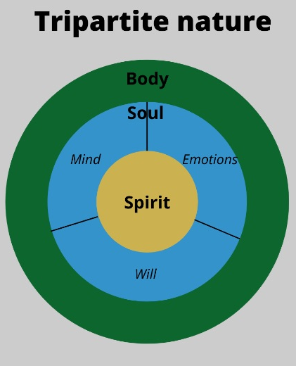
Conclusion
Importance of All Dimensions: The spirit, soul, and body are all essential components of a person.
Judgment of the Soul: It is the soul that will ultimately be judged and face the consequences of its actions.

Slide 7
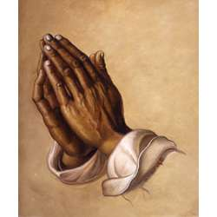
Closing Prayer
Heavenly Father,
On the day of judgment, may I not be found guilty of the actions I committed.
Please guide me throughout my life so that I may walk in righteousness and not sin.
Grant me eternal life in Your presence, free from sin and judgment to come.
In Jesus name

