Slide 1
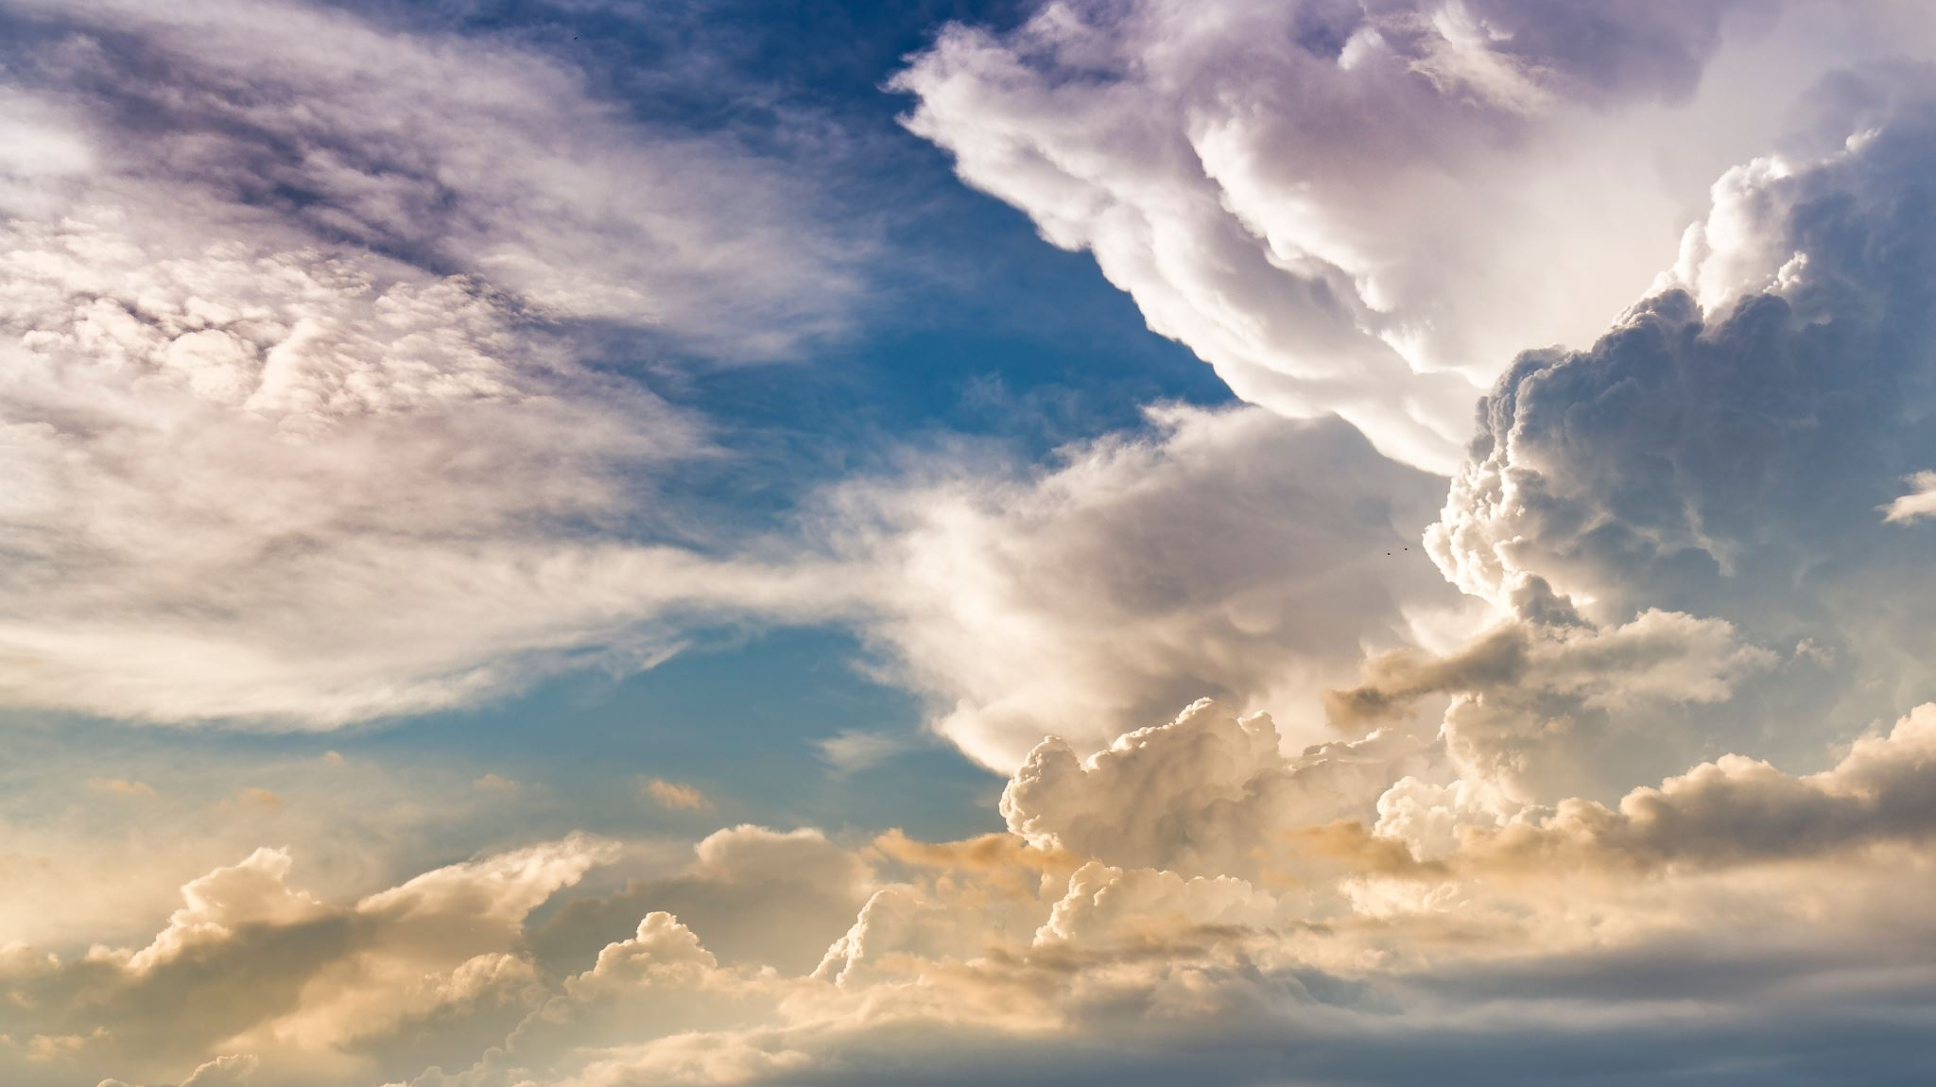

Kingdom of God
RCCG Sunday School, 1 Sept 2024 – Lesson 1

Slide 2
Text: 1 Chronicles 29:10-12
David praises God:
David acknowledges God's greatness and sovereignty before the congregation.
God's attributes:
God possesses greatness, power, glory, victory, and majesty.
God's dominion: Everything in heaven and earth belongs to God. God is the ultimate ruler.
God's source of blessings: Riches, honor, power, might, greatness, and strength come from God.

Slide 3
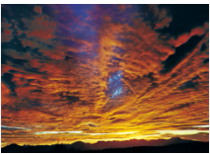
Kingdom of God:
Brief Overview
Spiritual and Physical: The Kingdom of God is both spiritual and physical.
Central to Jesus' Teaching: The core theme of Jesus' teachings.
God's Reign: is supreme in the spiritual realm.
Future Manifestation: God's righteous rule will be physically established.
Understanding God's Plan: is crucial for believers.

Slide 4
Aspects of the Kingdom of God
Universal Kingdom: God's eternal sovereignty over all creation.
Mediatorial Kingdom: God's rule through human representatives, culminating in Christ's millennial reign.
Spiritual Kingdom: The invisible realm of God's reign within believers' hearts, accessed through repentance and rebirth.

Slide 5
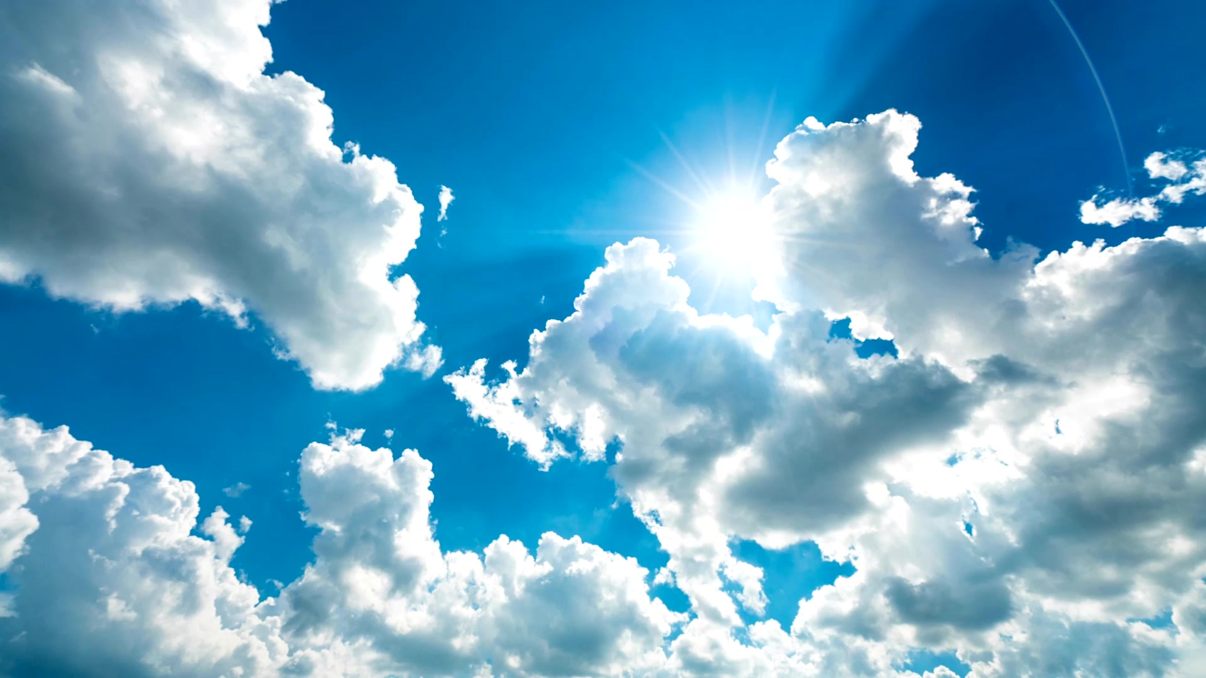
Seeking the Kingdom of God
Priority: Seek the Kingdom of God and His righteousness above all else.
Hunger and Thirst: Desire God's rule and reign in your life.
Submission: Yield to Christ's lordship and obey His will.
Key Benefit: Forgiveness of sins and righteousness, peace, and joy in the Holy Spirit.

Slide 6
Conclusion
Great Commission: We are called to share the good news of the Kingdom of God with others.
Open Invitation: All are welcome to enter the Kingdom by surrendering their lives to Jesus.
Eternal Life: The Kingdom offers eternal life and a relationship with God.
Action: Share your faith and invite others to experience the Kingdom of God.

Slide 7
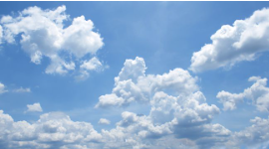
Prayers:
Heavenly Father,
Please give me boldness, clarity and effectiveness in witnessing the Kingdom of God
Please help me prioritise and seek God first with focus.
And the faith to endure, with perseverance with the assurance of making it to the kingdom
In Jesus name

