Slide 1


My Enemy:
The Flesh
RCCG Sunday School
29 Sept 2024
Lesson 5

Slide 2

Memory Verse
So then they that are in the flesh cannot please God.”
– Romans 8:8 (KJV)

Slide 3

Text Explained:
Romans 7:18-22
Paul Says:-
I recognize that my inner desires and actions often don't align.
I want to do good, instead, I frequently find myself doing evil.
This internal struggle isn't my fault; it's a result of sin in me.
Even when I want to do good, evil is always lurking nearby.
Despite these struggles, I still appreciate God's law.

Slide 4

Introduction- My Enemy, The Flesh
The world is our outward enemy.
We also have an internal enemy called "the flesh."
The Devil has a stronghold within us that works with him against us.
This stronghold is our sinful nature, also known as "the flesh."
Those controlled by the flesh are also called natural, carnal, or the old man.

Slide 5
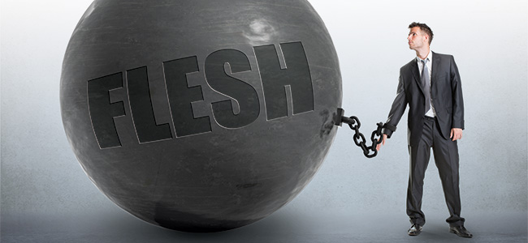
The "Flesh" Described
The flesh is not our physical body but our sinful nature.
Before salvation, "self" ruled our hearts.
Christ came to live within us after salvation.
"Self" still exists and desires to rule.
"Self" will never obey God.
Sin originates from our sinful nature.
The flesh is a stronghold for sin.
"Self" manifests in pride, love of self, pity, righteousness & wilfulness.

Slide 6

Victory Through God
To enter God's presence, our old sinful life must end.
God loves us and performed three acts:
  Ended our old self-life.
  Made us new persons in Christ.
  Gave Christ as our new Master.
Though we can't eliminate self, we can avoid its rule.
Choose to keep self cross-centred.
Make Christ our King.
Live the Christ-life by bearing the fruit of the Spirit.

Slide 7

Conclusion
Control your flesh with the assistance of the Holy Spirit.

Slide 8

Prayers
Father in heaven,
Help me to recogne the power of the flesh
Encourage me to seek freedom from sin
Assist me as I rely on the Holy Spirit
In Jesus name

