Slide 1

The Deity of Jesus
(Part 2)
RCCG Sunday School
15 Sep 2024, Lesson 3

Slide 2

Key points - John 14:6-11
Jesus is the only way to God
Knowing Jesus means knowing the Father
Jesus and the Father are one
Jesus' works reveal the Father
Belief in Jesus is essential

Slide 3

Introduction
Jesus' Divine Nature: He is truly God.
Equality with God: Exists in the same form
Miraculous Works: Demonstrate divine power
The Way, the Truth, and the Life: Only path to God

Slide 4
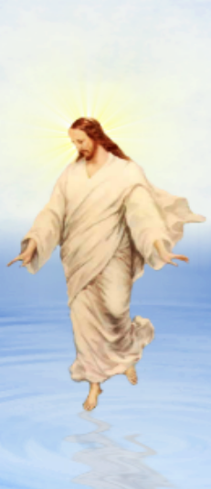
The Miracles Jesus Performed
Miracles are supernatural acts of God
Demonstrate God's involvement in human history
Jesus performed many miracles: These included turning water into wine, walking on water, multiplying food, healing the sick, and raising the dead.
The most significant miracle: Jesus Himself rose from the dead.
No other religion can claim this: Unique to Christianity.

Slide 5

The Way, the Truth, & the Life
Jesus is the only way to God: There is no other path to heaven.
Jesus - source of all truth: Personification of God's law.
Jesus has authority over life: He can give and take life.
Jesus offers deliverance from sin and death: He provides eternal freedom and victory.

Slide 6

Conclusion
Jesus Christ is undeniably God: No doubt about His divine nature.
Denying His divinity is dangerous: Reject His authority at your own peril.
Embrace the truth: Accept Jesus as God and experience the blessings of salvation.

Slide 7
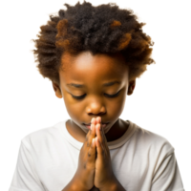
PRAYERS
Dear Father,
I acknowledge Your awesome Power
Fill my life with Your mighty deeds, so that others may see Your glory in me.
I declare Jesus as my only way
In Jesus name

