Slide 1

The Cost Of Discipleship
Pastor’s Summary
RCCG Sunday School
Lesson 7
13 October 2024

Slide 2
Memory Verse
1 John 2:6 KJV
Bible
He that saith he abideth in Him ought himself also so to walk, even as He walked
It Means
If someone says they live in harmony with Jesus, they should live their lives the same way Jesus lived.

Slide 3

Text: Luke
9:57-62
Someone wants to follow Jesus everywhere.
Jesus responds saying it won't be easy, and no place to rest.
Two others want to follow but delay with excuses: one needs to bury his father, the other needs to say bye to his family.
Jesus says they should rather focus on spreading the good news of God's kingdom instead of delaying.
Jesus emphasises that those who follow Him must be fully committed and not look back.

Slide 4
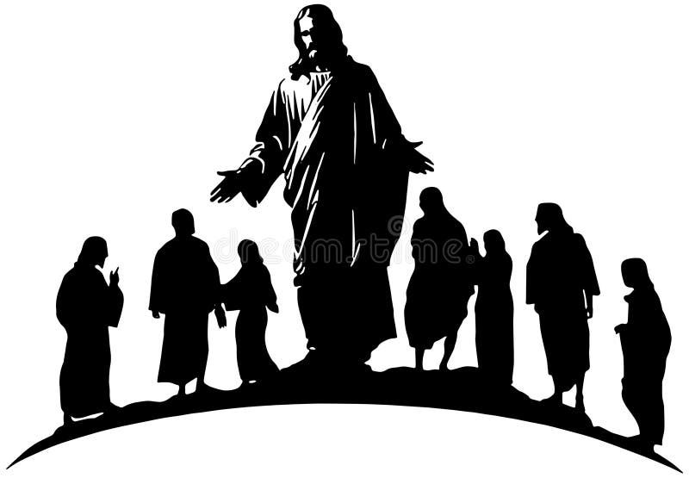
Introduction –Cost of Dicipleship
Disciple: A follower of Christ who learns from Him.
Discipline: Self-control and obedience to rules.
Disciple's Attitude Towards Sin: How a disciple should view and respond to sin.
Key Disciplines: Know the essential practices of a true disciple.

Slide 5
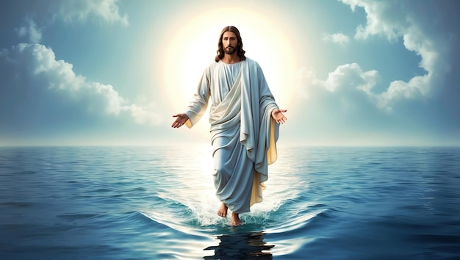
What Would Jesus Do?

Slide 6
Disciple’s Attribute
Starting Point is forgiveness of sins and reconciliation with God through Jesus.
Life-Long Learning: Disciples learn to live like Jesus.
Key Attributes are:
Obedience to God's will | Zeal for God
Sin-free life | Unconditional love
Burden for soul winning | Sacrificial living
Humility and obedience | Overcoming lust

Slide 7
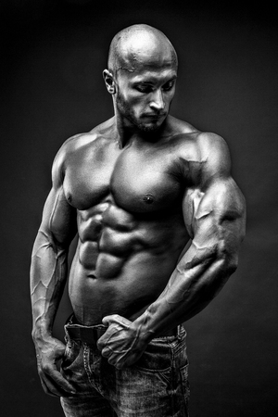
Key Disciplines (The 4 Ps)
Purposefulness: Be focused and determined to follow Jesus and His kingdom.
Perseverance: Stay focused, avoid distractions, and persist in spreading the word.
Promptness: Do things immediately and avoid procrastination.
Permanence: Give up old habits and ways that are no longer compatible with Jesus.

Slide 8
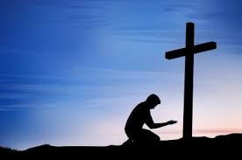
Conclusion
Disciples must remain committed, dedicated and faithful to Jesus.
Staying true to Jesus leads to great success in discipleship.
Faithful disciples will be rewarded for their dedication and perseverance.
The ultimate reward for faithful disciples is eternal life with Jesus.

Slide 9
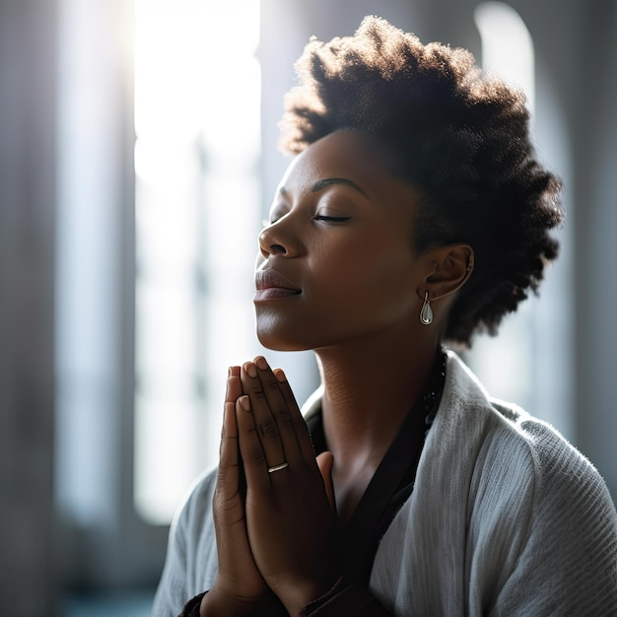
Prayers
Dear Father,
Please strengthen my resolve to follow You wholeheartedly
Please grant me the strength to overcome challenges hindering my discipleship
Please help me to grow in my understanding live a Christ-Like Life.
In Jesus name Amen

