Slide 1
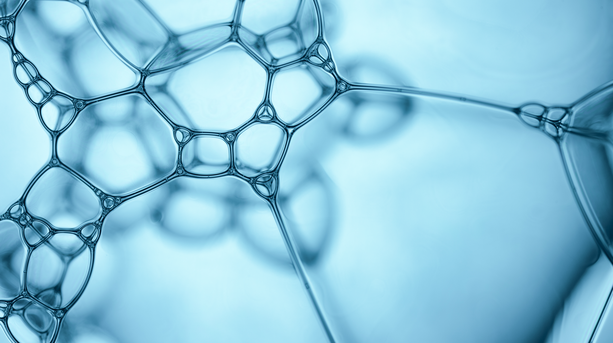

I know who I am
RCCG Sunday School
6 Oct 2024 - Lesson 6

Slide 2
Memory Verse
2 Cor 5:17
If any man be in Christ, he is a new creature: old things are passed away; behold, all things are become new
Bible
If someone has accepted Jesus Christ into their life, they have become a completely new person. Their old way of life is gone, and they have a fresh start.
Means

Slide 3
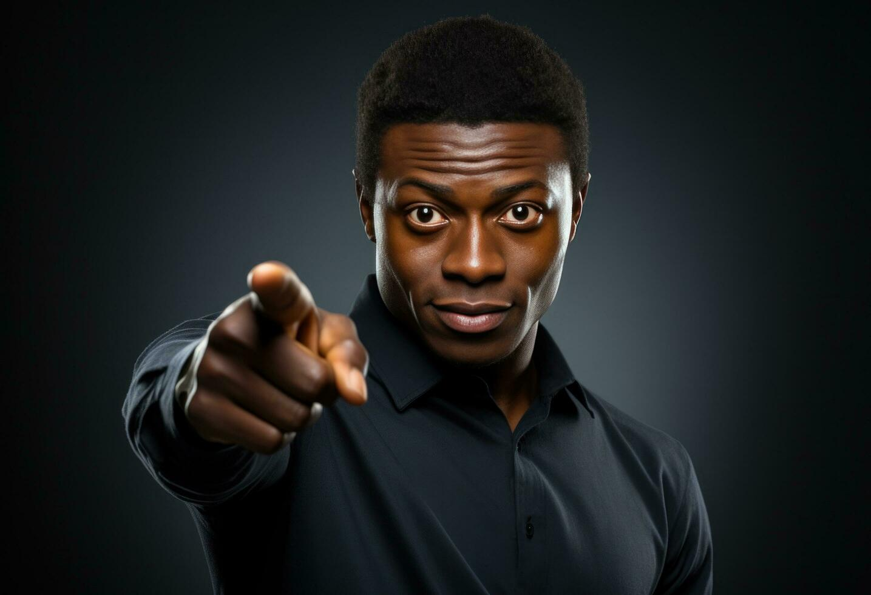
Matthew 16:13-17
Jesus asks his guys who people think he is.
They answer with various guesses, including figures like John the Baptist and Elijah.
Jesus then asks Simon Peter directly who he believes Jesus is.
Peter boldly declares that Jesus is the Christ, the Son of the living God.
Jesus praises Peter for this revelation, saying it came from God, not human understanding.
Matthew
16:13-17

Slide 4
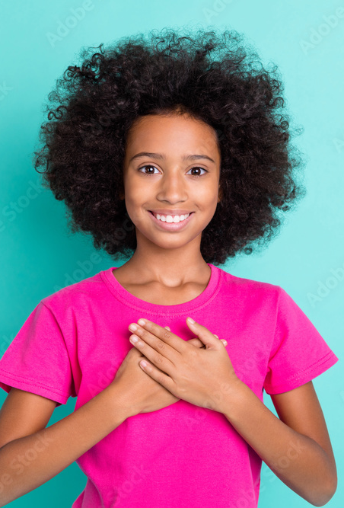
Intro - I Know Who I Am
Every true child of God should know their identity with confidence.
Knowing who you are can significantly impact your life.
A child of God should boldly declare their identity as such.
This declaration should be backed up by their actions and character.

Slide 5
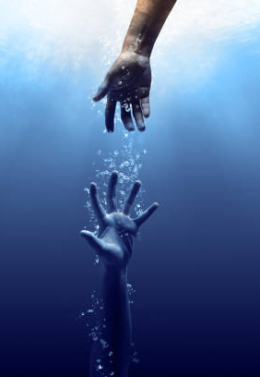
Being Born Again
Believers are reborn spiritually.
God’s mercy makes this possible.
Once dead, but now alive through Christ.
Their sins are forgiven.
Their nature changes.
They are not part of this world.
They are like strangers passing through.
The world doesn’t influence them much.

Slide 6
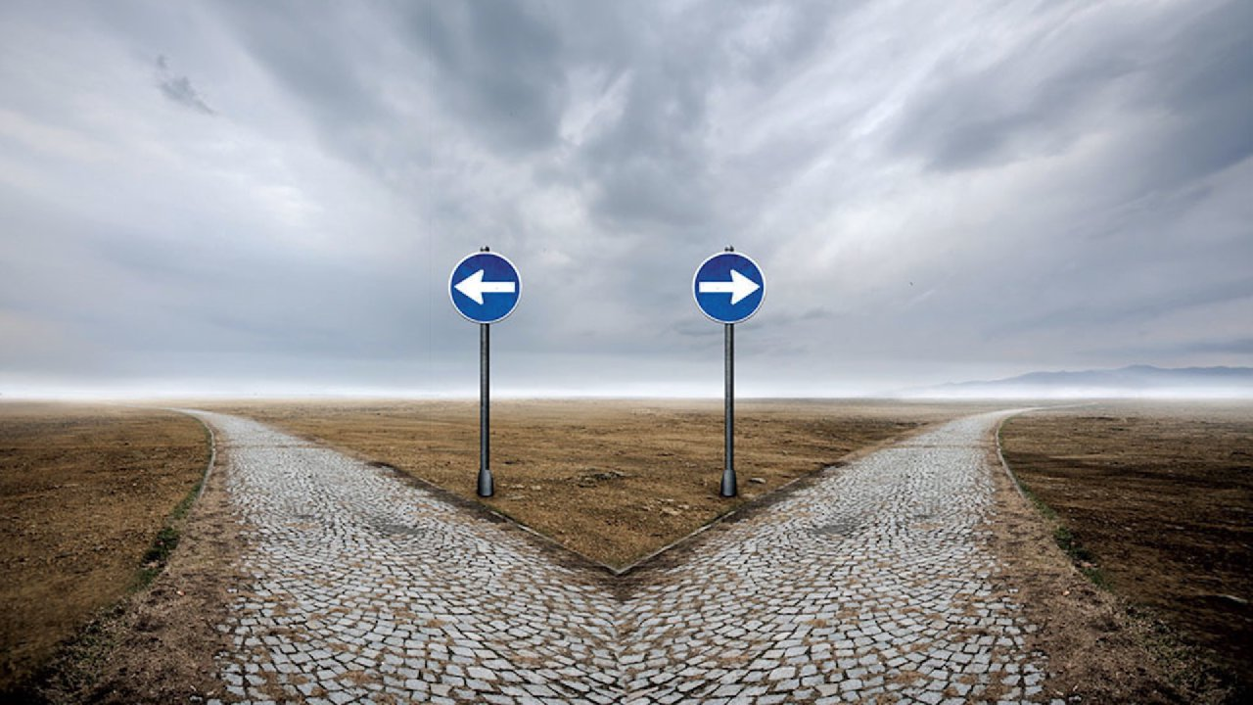
A Changed Person
When someone accepts Christ, their identity changes.
They become saints instead of sinners.
Their focus shifts from earthly things to attaining Heaven.
Their lifestyle changes, including their words, actions, and behaviour
They strive to please God in everything they do.

Slide 7
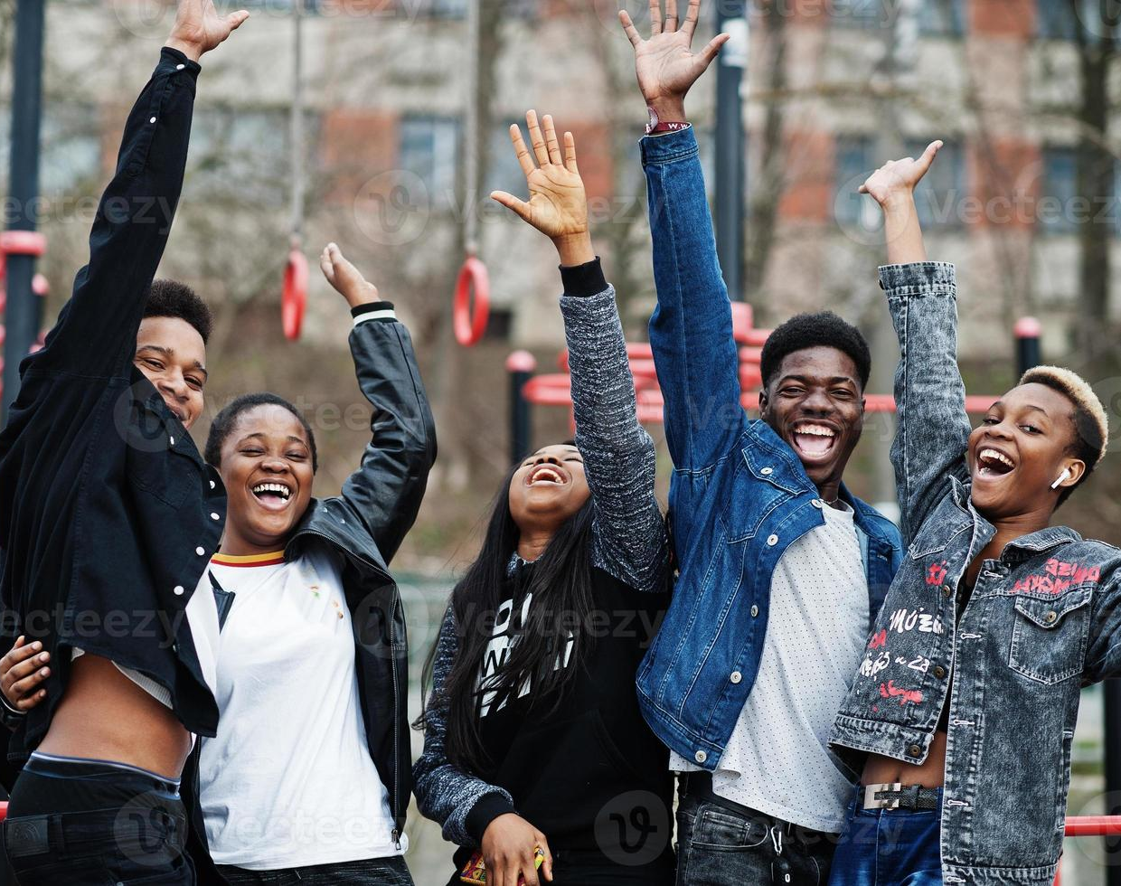
Conclusion
Embracing your identity in Christ is a powerful declaration of faith.
As you confidently share your testimony, let your words and actions inspire others to seek the same transformation.

Slide 8
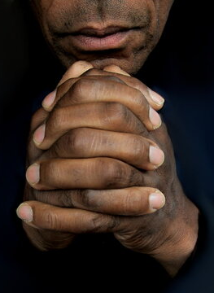
  Prayers
  Dear Father
  Please grant me a clear understanding of my identity in You.
  Please continue to transform my heart and mind to divinely align my thoughts, words, and actions.
  Please use me to inspire, encourage make a difference in the world.
  In Jesus name

