Slide 1

The Power of Forgiveness
RCCG Sunday School
20 October 2024
Lesson 8

Slide 2
Memory Verse - Colossians 3:13 (KJV)
THE BIBLE SAYS
WHAT IT MEANS
Forbearing one another, and forgiving one another, if any man have a quarrel against any: even as Christ forgave you, so also do ye.” –
"Be patient with each other and forgive each other, especially when you have a disagreement. Just as Christ forgave you, you should forgive others too."

Slide 3

Genesis 50:17-20
Joseph's brothers, who had once sold him into slavery, now beg for his forgiveness. They acknowledge their wrongdoing and plead for mercy.
Despite their past betrayal, Joseph weeps and forgives his brothers. He reminds them that he is not God and that their actions, though intended for evil, were ultimately used by God for good.
Joseph emphasizes that God had a plan for his life, even through the hardships he faced. His suffering ultimately led to the salvation of many people.

Slide 4

Introduction - Power of Forgiveness
Definition: Forgiveness is choosing to let go of negative feelings like anger and resentment towards someone who has wronged you.
Challenge: Struggle to forgive those who have hurt you.
Biblical Importance: Emphasizes that forgiveness is essential for believers, as God's forgiveness is linked to our own willingness to forgive others
Need: Understanding why forgiveness is crucial and learning how to practice it are essential for believers.

Slide 5

Reasons Christians Should Forgive
Peacemaking: Forgiveness is essential for maintaining peace with others
Healing: As Christians, we should not only forgive but also work towards healing relationships
Divine Command: It is a direct command from God
Example: We are called to be examples of forgiveness
God's Anger: Displeased with those who refuse to forgive
Prayer Hindrance: Unforgiveness hinders prayers
Personal Need: We all need forgiveness from God

Slide 6

Achieving True Forgiveness
Benefits: Forgiveness can improve physical and mental health, boost self-esteem, and bring peace of mind.
REACH Model:
  Reflect: Think clearly about the wrong done.
  Empathize: Understand the offender's point of view.
  Acknowledge: Recognize your own need for forgiveness and offer it.
  Commit: Share your decision to forgive with someone.
  Hold: Stay committed to forgiveness, even when it's hard.

Slide 7

Conclusion
Costly but Rewarding: Forgiveness may require effort, but the benefits far surpass the pain.
Embrace Forgiveness: Choose to forgive those who have wronged you.

Slide 8
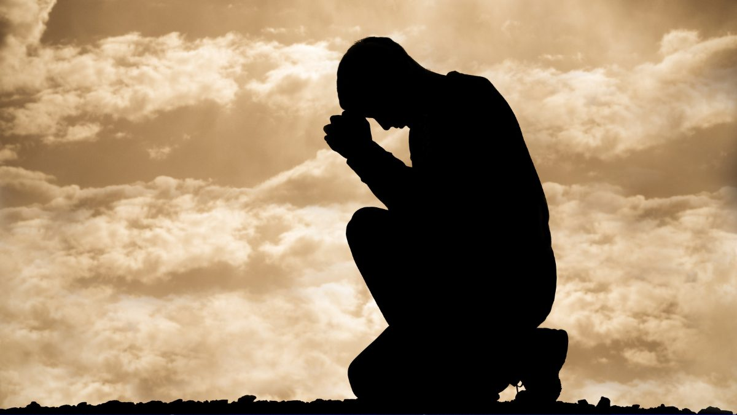
Prayers
Dear Father
Please soften my heart and fill it with compassion.
Please give me the strength to let go of bitterness, anger, and resentment. I choose forgiveness.
Please heal the wounds caused by past hurts and let forgiveness set me free.
In Jesus name

